Slide 1
How to trick your brain doing hard things ?
A dopamine story
Charles Vin

Slide 2

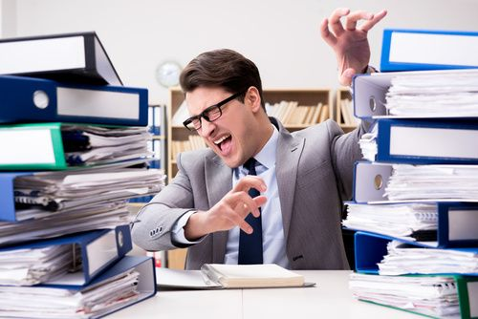
Notes:
spend hours scrolling social media //stay focused studying -> dopamine

Slide 3
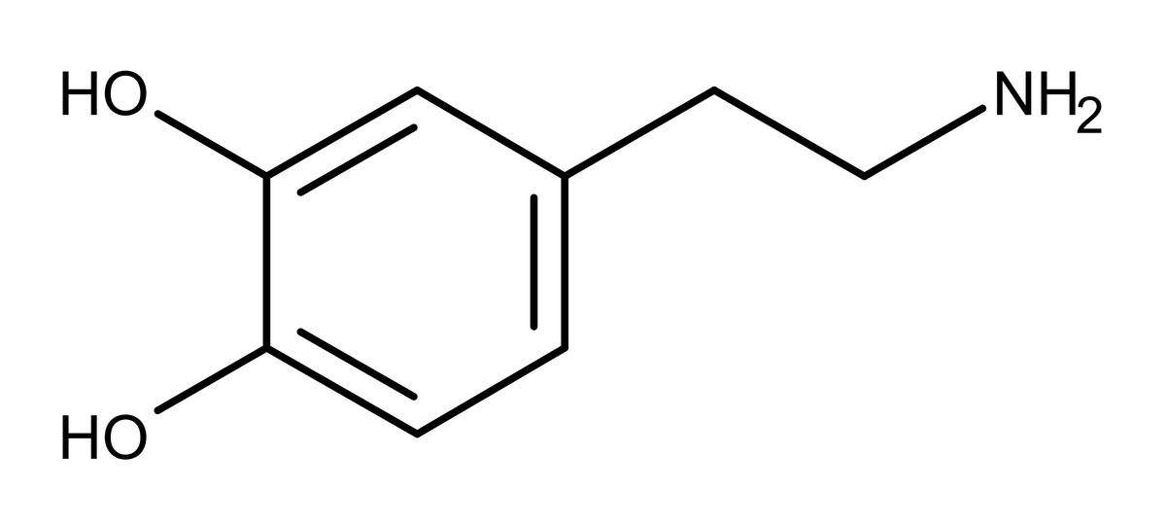
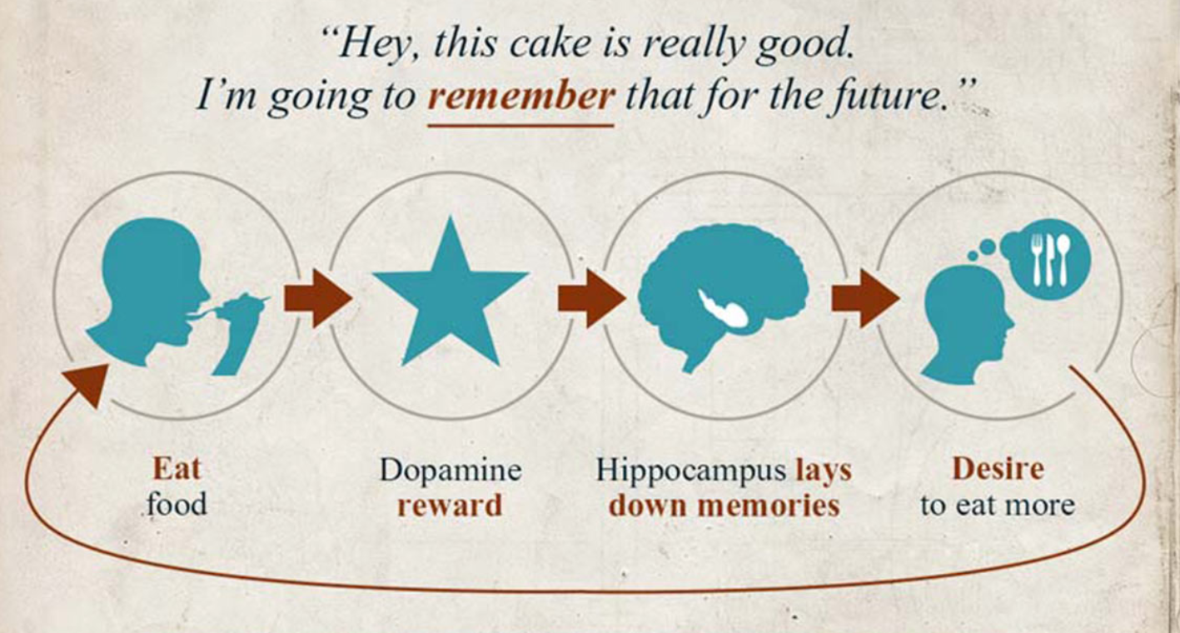
Dopamine
Dopamine
“Just one more”
“Just one more”
Notes:
brain chemical of anticipation because you’re expecting a reward
brain reward system
Reason why can’t focus for a long period of time/lack of motivation to work on things that could have a great impact on your life whereas you can scroll Tiktok for hours.
But lets start from the beginin

Slide 4
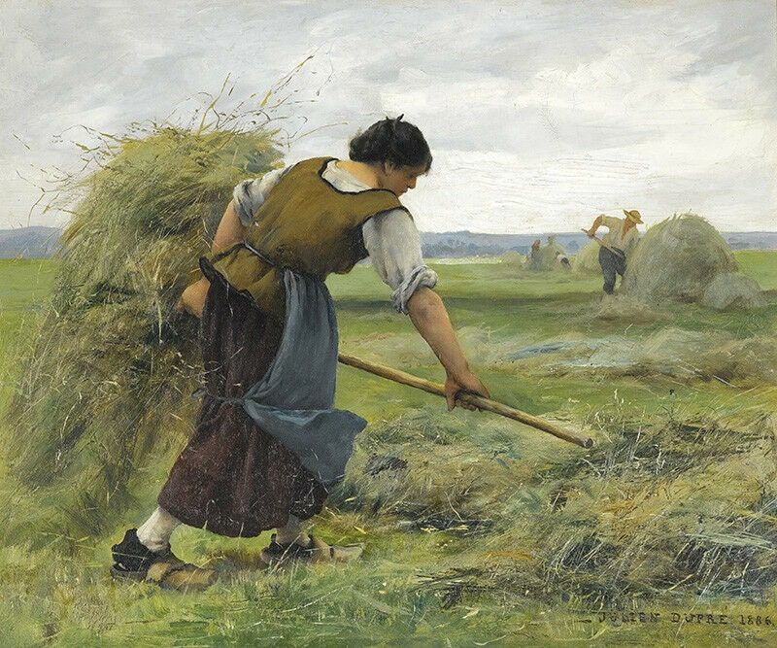
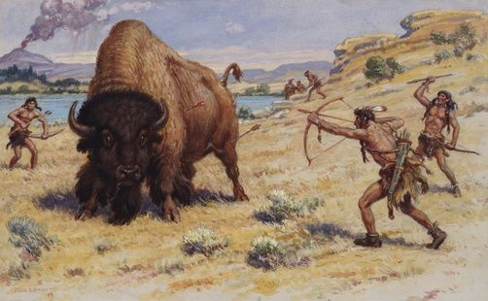
At the beginning
Notes:
day and age of the first human, dopamine = eat, hunting, reproducing, nothing much
But then humanity discovered other triggers for the reward system

Slide 5
What produce dopamine ?
Notes:
Drugss… porn…. Gambling machine …. Video game and finaly …. Social media
-> lot of dopamine -> strong motivation
All this kind of entertainment produces a lot of dopamine and create a strong motivation for those activities.
This can create a sort of chemical imbalance in our brain.
So, to stabilized itself, the brain will involve one of his best skills: adaptation and more precisely it will adapt through tolerance.

Slide 6
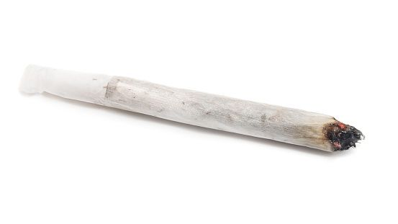
What produce dopamine ?
Notes:
Drugss… porn…. Gambling machine …. Video game and finaly …. Social media
-> lot of dopamine -> strong motivation
All this kind of entertainment produces a lot of dopamine and create a strong motivation for those activities.
This can create a sort of chemical imbalance in our brain.
So, to stabilized itself, the brain will involve one of his best skills: adaptation and more precisely it will adapt through tolerance.

Slide 7
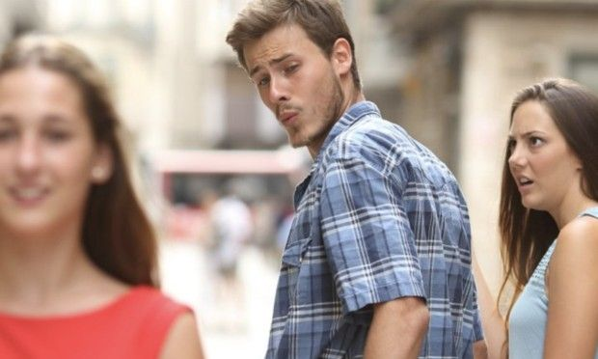
What produce dopamine ?
Notes:
Drugss… porn…. Gambling machine …. Video game and finaly …. Social media
-> lot of dopamine -> strong motivation
All this kind of entertainment produces a lot of dopamine and create a strong motivation for those activities.
This can create a sort of chemical imbalance in our brain.
So, to stabilized itself, the brain will involve one of his best skills: adaptation and more precisely it will adapt through tolerance.

Slide 8

What produce dopamine ?
Notes:
Drugss… porn…. Gambling machine …. Video game and finaly …. Social media
-> lot of dopamine -> strong motivation
All this kind of entertainment produces a lot of dopamine and create a strong motivation for those activities.
This can create a sort of chemical imbalance in our brain.
So, to stabilized itself, the brain will involve one of his best skills: adaptation and more precisely it will adapt through tolerance.

Slide 9
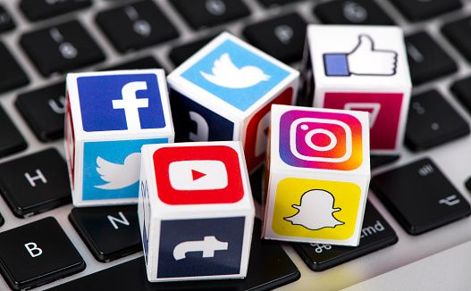
What produce dopamine ?
Notes:
Drugss… porn…. Gambling machine …. Video game and finaly …. Social media
-> lot of dopamine -> strong motivation
All this kind of entertainment produces a lot of dopamine and create a strong motivation for those activities.
This can create a sort of chemical imbalance in our brain.
So, to stabilized itself, the brain will involve one of his best skills: adaptation and more precisely it will adapt through tolerance.

Slide 10
What produce dopamine ?
Notes:
Drugss… porn…. Gambling machine …. Video game and finaly …. Social media
-> lot of dopamine -> strong motivation
All this kind of entertainment produces a lot of dopamine and create a strong motivation for those activities.
This can create a sort of chemical imbalance in our brain.
So, to stabilized itself, the brain will involve one of his best skills: adaptation and more precisely it will adapt through tolerance.

Slide 11
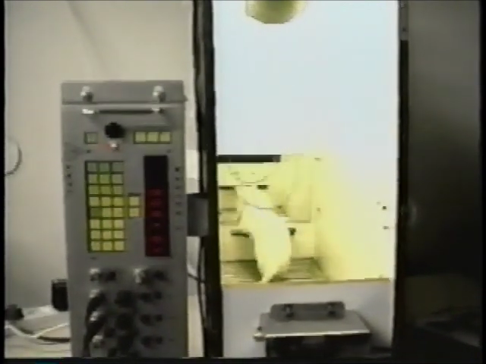
Motivation Self Stimulation in Rats
Notes:
Rat -> lever -> electrode -> nucleus accumbens=part of reward system
Lever = instant shoot of dopamine
So motivated , event if there was an electrified grid at their foot = continuous shook
So lazy = did not walk to get food at the opposite of the cage
CCL : -> reward system, full control without any substances , even if those action can be bad for our body

Slide 12
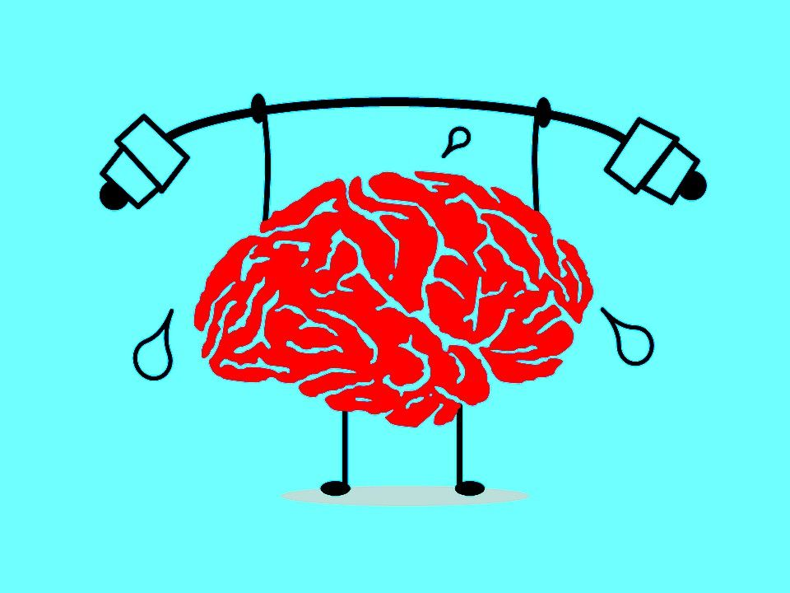
Plasticity
Notes:
Don’t worry, without the use of addictive chemicals, this don’t append to human because our brain got an incredible superpower: plasticity!
Plasticity = capacity to rewire itself and adapt to new situation.
-> learn new hard thing like reading, walking with a prosthesis but it also permits us to develop tolerance effect.
……..

Slide 13
Tolerance
Notes:
The tolerance effect explains why an alcoholic need more alcohol to be drunk compared to a normal drinker. Or at a smaller scale, this can explain why the last bite of your favorite food is nether as good as the first.
….
Let’s apply this idea to dopamine, the more you consume high dopamine activities, the more you will need a high dopamine activity to get stimulated and motivated. This is a vicious circle that modify your baseline level of happiness.
…
In other word, you will lose motivation to accomplished low dopamine activities such as studying or meditating. Deep focusing in those thing will become really hard as some studies showed that 90% of distraction are internal. The motivation to stay focus is so low that you attention can stabilized, even if you know those activities are much more important than scrolling Tiktok.
This can create negative feelings, especially if you compare yourself to some YouTube productivity god. But they're not gods, you’re not lazy, it just different tolerance level! So you may be thinking “ok ok how can I reduce tolerance, is there a way to reset my brain” and yes there is a solution and it’s called dopamine detox!
……….

Slide 14
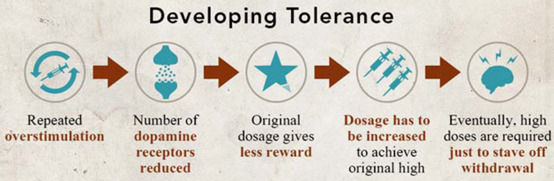
Tolerance
Notes:
The tolerance effect explains why an alcoholic need more alcohol to be drunk compared to a normal drinker. Or at a smaller scale, this can explain why the last bite of your favorite food is nether as good as the first.
….
Let’s apply this idea to dopamine, the more you consume high dopamine activities, the more you will need a high dopamine activity to get stimulated and motivated. This is a vicious circle that modify your baseline level of happiness.
…
In other word, you will lose motivation to accomplished low dopamine activities such as studying or meditating. Deep focusing in those thing will become really hard as some studies showed that 90% of distraction are internal. The motivation to stay focus is so low that you attention can stabilized, even if you know those activities are much more important than scrolling Tiktok.
This can create negative feelings, especially if you compare yourself to some YouTube productivity god. But they're not gods, you’re not lazy, it just different tolerance level! So you may be thinking “ok ok how can I reduce tolerance, is there a way to reset my brain” and yes there is a solution and it’s called dopamine detox!
……….

Slide 15
Tolerance
Tolerance
Need more stimulating activities to get motivated
High dopamine activities
Craving for high dopamine activities
Notes:
The tolerance effect explains why an alcoholic need more alcohol to be drunk compared to a normal drinker. Or at a smaller scale, this can explain why the last bite of your favorite food is nether as good as the first.
….
Let’s apply this idea to dopamine, the more you consume high dopamine activities, the more you will need a high dopamine activity to get stimulated and motivated. This is a vicious circle that modify your baseline level of happiness.
…
In other word, you will lose motivation to accomplished low dopamine activities such as studying or meditating. Deep focusing in those thing will become really hard as some studies showed that 90% of distraction are internal. The motivation to stay focus is so low that you attention can stabilized, even if you know those activities are much more important than scrolling Tiktok.
This can create negative feelings, especially if you compare yourself to some YouTube productivity god. But they're not gods, you’re not lazy, it just different tolerance level! So you may be thinking “ok ok how can I reduce tolerance, is there a way to reset my brain” and yes there is a solution and it’s called dopamine detox!
……….

Slide 16
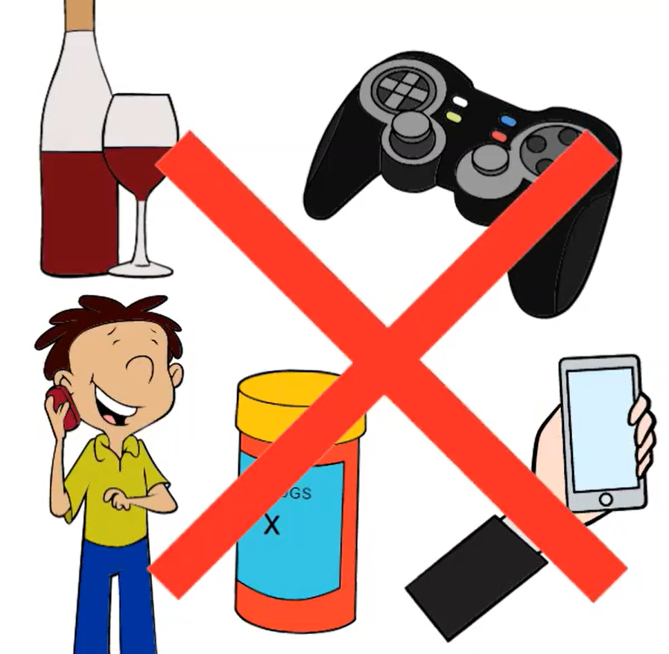
Dopamine detox
Notes:
By removing any high dopamine activities during a certain amount of time, you can rewire your brain the other way around to get back motivation, productivity, and self-confidence. Doing this suddenly is pretty hard but you can choose to go step by step too. It means no Netflix, no porn, no social media, no junk food. And this will be boring but in one week the desire to doing such things will disappear and boredom will force you to engage in low dopamine activities as there will be nothing more stimulating in your environment. Checking thing in your to-do will make you accomplish, you may start to feel more calm, thinking clearer, being more center, more present ……..

Slide 17
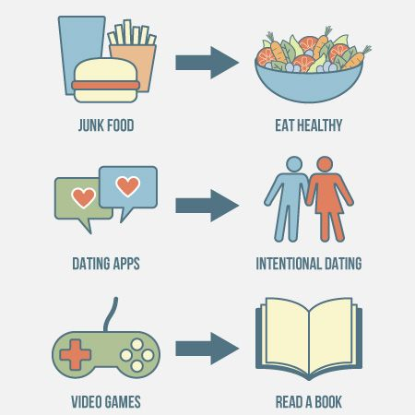
Dopamine detox
Notes:
By removing any high dopamine activities during a certain amount of time, you can rewire your brain the other way around to get back motivation, productivity, and self-confidence. Doing this suddenly is pretty hard but you can choose to go step by step too. It means no Netflix, no porn, no social media, no junk food. And this will be boring but in one week the desire to doing such things will disappear and boredom will force you to engage in low dopamine activities as there will be nothing more stimulating in your environment. Checking thing in your to-do will make you accomplish, you may start to feel more calm, thinking clearer, being more center, more present ……..

Slide 18

Being aware of a problem is the first step to resolving it.
Notes:
Now that you know the principle and the existence of Dopamine. You may be able to identify more precisely the thing that private you from being motivated. Cause remember, dopamine fasting is the most radical way to deal with that as it removes all the possible source of Dopamine imbalance. It can first help you to identify the problem, but then it will be easier to focus on something more precise. We know that doing sport boost the mood, that social media create anxiety, that massive entertainment is sometime a way to avoid addressing emotion or mental illness. There are many path to achieve productivity and it your role to find the best for you.

